Slide 2
SESSION 4
The Dad Factor

Slide 3
1
Why Is Dad So Important?

Slide 4
1
Why Is Dad So Important?
Dad is destiny.

Slide 5
1
Why Is Dad So Important?
Dad is destiny.
The positive presence of dad in a family shapes in many ways, a healthy masculinity in his sons and a healthy femininity in his daughters.

Slide 6
2
Three Types of Dad:

Slide 7
2
Three Types of Dad:
The problematic dad.

Slide 8
2
Three Types of Dad:
The problematic dad.
The good dad.

Slide 9
2
Three Types of Dad:
The problematic dad.
The good dad.
The smart dad.

Slide 10
2
Three Types of Dad:
The problematic dad.
The good dad.
The smart dad.
  He has developed (or adopted) an intentional “dad plan” for meeting those needs.

Slide 11
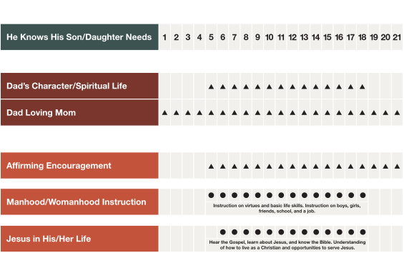
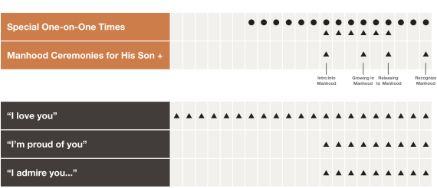


Slide 12
2
Three Types of Dad:
The problematic dad.
The good dad.
The smart dad.
  He has developed (or adopted) an intentional “dad plan” for meeting those needs.
  He has committed himself to “dad plan” follow through.

Slide 13
3
Helpful Advice to Fathers with Challenges:

Slide 14
3
Helpful Advice to Fathers with Challenges:
If you’re a dad “disconnected” personally and emotionally from your son or daughter, know it’s never too late to close this gap no matter how old they are.

Slide 15
3
Helpful Advice to Fathers with Challenges:
If you’re a dad “disconnected” personally and emotionally from your son or daughter, know it’s never too late to close this gap no matter how old they are.
If you’re a single dad through divorce or death, or a dad with a blended family, don’t guess at your situation. Instead, seek outside help and wisdom to build a sound parenting strategy for going forward.

Slide 16
4
Helpful Advice to Sons With A Dad Wound:

Slide 17
4
Helpful Advice to Sons With A Dad Wound:
Approach your dad wound responsibly.

Slide 18
4
Helpful Advice to Sons With A Dad Wound:
Approach your dad wound responsibly.
  Choose to forgive your dad.

Slide 19
4
Helpful Advice to Sons With A Dad Wound:
Approach your dad wound responsibly.
  Choose to forgive your dad.
  Choose to release your dad to God.

Slide 20
4
Helpful Advice to Sons With A Dad Wound:
Approach your dad wound responsibly.
  Choose to forgive your dad.
  Choose to release your dad to God.
Take the initiative with your dad. Don’t wait for him to
come to you.

Slide 21
4
Helpful Advice to Sons With A Dad Wound:
Approach your dad wound responsibly.
  Choose to forgive your dad.
  Choose to release your dad to God.
Take the initiative with your dad. Don’t wait for him to
come to you.
Ask your dad to bless you.

Slide 22
4
Helpful Advice to Sons With A Dad Wound:
Approach your dad wound responsibly.
  Choose to forgive your dad.
  Choose to release your dad to God.
Take the initiative with your dad. Don’t wait for him to
come to you.
Ask your dad to bless you.
Reclaim the relationship you missed with your dad by
becoming a smart dad that blesses your children.

