Slide 2
SESSION 10
A Real Man Betters God’s World

Slide 3
1
A Man And His Children:

Slide 4
1
A Man And His Children:
God’s first recorded command to man in the Bible is,
“Be a dad!”

Slide 5
1
A Man And His Children:
God’s first recorded command to man in the Bible is,
“Be a dad!”
Children are given by God to enrich a man’s life in a multitude of ways.

Slide 6
1
A Man And His Children:
God’s first recorded command to man in the Bible is,
“Be a dad!”
Children are given by God to enrich a man’s life in a multitude of ways.
Children give a dad a way to make some of his most significant and enduring contributions to bettering this world.

Slide 7
1
A Man And His Children:
God’s first recorded command to man in the Bible is,
“Be a dad!”
Children are given by God to enrich a man’s life in a multitude of ways.
Children give a dad a way to make some of his most significant and enduring contributions to bettering this world.
This requires being a “Smart Dad.”

Slide 8
2
What Your Children Would Say They Most
Need From You As Dad:

Slide 9
2
What Your Children Would Say They Most
Need From You As Dad:
“Dad, I need you and Mom to be there for me in my early years.”

Slide 10
2
What Your Children Would Say They Most
Need From You As Dad:
“Dad, I need you and Mom to be there for me in my early years.”
“Dad, I need your discipline and instruction to be balanced with love.”

Slide 11
High ____
Low
Discipline/
Instruction
High
Discipline/
Instruction
Low ____

Slide 12
High Love
Low
Discipline/
Instruction
High
Discipline/
Instruction
Low ____

Slide 13
High Love
Low
Discipline/
Instruction
High
Discipline/
Instruction
Low Love

Slide 14
High Love
Permissive
Low
Discipline/
Instruction
High
Discipline/
Instruction
Low Love

Slide 15
High Love
Permissive
Authoritative
Low
Discipline/
Instruction
High
Discipline/
Instruction
Low Love

Slide 16
High Love
Permissive
Authoritative
Low
Discipline/
Instruction
High
Discipline/
Instruction
Neglectful
Low Love

Slide 17
High Love
Permissive
Authoritative
Low
Discipline/
Instruction
High
Discipline/
Instruction
Neglectful
Authoritarian
Low Love

Slide 18
2
What Your Children Would Say They Most
Need From You As Dad:

Slide 19
2
What Your Children Would Say They Most
Need From You As Dad:
“Dad, I need you and Mom to be there for me in my early years.”

Slide 20
2
What Your Children Would Say They Most
Need From You As Dad:
“Dad, I need you and Mom to be there for me in my early years.”
“Dad, I need your discipline and instruction to be balanced with love.”

Slide 21
2
What Your Children Would Say They Most
Need From You As Dad:
“Dad, I need you and Mom to be there for me in my early years.”
“Dad, I need your discipline and instruction to be balanced with love.”
“Dad, I need you to know my personality and honor it.”

Slide 22
2
What Your Children Would Say They Most
Need From You As Dad:
“Dad, I need you and Mom to be there for me in my early years.”
“Dad, I need your discipline and instruction to be balanced with love.”
“Dad, I need you to know my personality and honor it.”
“Dad, I need you to discover my “bent” and actively support it.”

Slide 23
2
What Your Children Would Say They Most
Need From You As Dad:
“Dad, I need you to know too much is too much.”
E.

Slide 24
2
What Your Children Would Say They Most
Need From You As Dad:
“Dad, I need you to know too much is too much.”
  Too much control over your child’s life crushes the spirit and incites rebellion.
E.

Slide 25
2
What Your Children Would Say They Most
Need From You As Dad:
“Dad, I need you to know too much is too much.”
  Too much control over your child’s life crushes the spirit and incites rebellion.
  Too much money in your child’s life will spoil them and steal their will to succeed.
E.

Slide 26
2
What Your Children Would Say They Most
Need From You As Dad:
“Dad, I need you to know too much is too much.”
  Too much control over your child’s life crushes the spirit and incites rebellion.
  Too much money in your child’s life will spoil them and steal their will to succeed.
  Too high expectations for your child wounds and embitters them.
E.

Slide 27
2
What Your Children Would Say They Most
Need From You As Dad:
“Dad, I need you to know too much is too much.”
  Too much control over your child’s life crushes the spirit and incites rebellion.
  Too much money in your child’s life will spoil themand steal their will to succeed.
  Too high expectations for your child wounds and embitters them.
“Dad, I need you to show me what to believe by living it.”
E.
F.

Slide 28
2
What Your Children Would Say They Most
Need From You As Dad:
“Dad, I need you to bless me.”
G.

Slide 29
2
What Your Children Would Say They Most
Need From You As Dad:
“Dad, I need you to bless me.”
“Dad, I need you to adjust your leadership style to me as I grow up.”
G.
H.

Slide 30
2
What Your Children Would Say They Most
Need From You As Dad:
“Dad, I need you to bless me.”
“Dad, I need you to adjust your leadership style to me as I grow up.”
“Dad, I need to make some great memories with you.”
G.
H.
I.
I.

Slide 31
2
What Your Children Would Say They Most
Need From You As Dad:
“Dad, I need you to bless me.”
“Dad, I need you to adjust your leadership style to me as I grow up.”
“Dad, I need to make some great memories with you.”
“Dad, I need you to talk to me about God and share His Word with me.”
G.
G.
H.
H.
I.
I.
J.
J.

Slide 32
3
Final Thoughts:

Slide 33
3
Final Thoughts:
Children are God’s gifts to us.

Slide 34
3
Final Thoughts:
Children are God’s gifts to us.
  We feel that “gifting” most in two “wow” moments:

Slide 35
3
Final Thoughts:
Children are God’s gifts to us.
  We feel that “gifting” most in two “wow” moments:
Children are our best, long-term opportunity to better God’s world.

Slide 36
3
Final Thoughts:
Children are God’s gifts to us.
  We feel that “gifting” most in two “wow” moments:
Children are our best, long-term opportunity to better God’s world.
The smart dad knows he needs God to succeed.

Slide 37
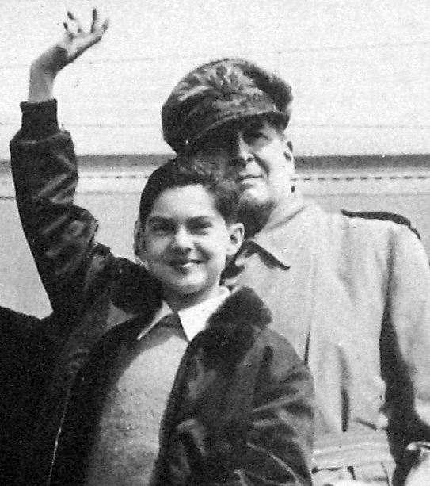

Slide 38
“Then I, his father, will dare to whisper,
‘I have not lived my life in vain.’”

